Slide 1
Midterm Presentation NLP Concept Extraction for Bug localization
Gabriel Pawlowsky
Mentor: Naveen Kulkarni, Sunil Vuppala
Co-Mentor: Nitin Agarwal

Slide 2
Contents
Introduction
My Project
Noun extraction
Keyword extraction - Filtering
Concept identification
Results

Slide 3
Introduction
Extension to the Infosys Automation Platform (IAP) of Mana
Based on Natural Language Processing (NLP)
Entire Project
Fast, accurate and automated bug localization to aid resolution of L3 tickets
NLP Concept extraction from bug reports, source code documentation and online bug resolutions
Gaining an understanding of the concept’s interactions and resolution
Suggesting areas of the source code (files) in which the bug most likely occurred to a developer to aid them in fixing it

Slide 4
My project
Concept extraction from source code documentation in Java

Slide 5
Noun extraction
Reading Spark documentation (Programming & Streaming guides)
Using many common NLP techniques
Started with the OpenNLP library
But changed project structure to work with the Stanford CoreNLP librarz due to better support of lemmatization
Tokenization
Split documentation by stop words to analyze words individually
Part of Speech (POS) – Tagging
Distinguish between verbs, nouns, plural nouns, etc.
Lemmatization
Put words into canonical form to treat e.g. go, went and gone all as go

Slide 6
Noun Extraction - Continued
Formation of Bi- and Tri-grams
For Bigrams, candidate terms as combinations of Verb-Noun and Noun-Noun occurring together considered
For Trigrams, combinations of Verb-Noun-Noun and Noun-Noun-Noun
Text Frequency calculation for candidate terms
How often does each candidate term occur in the entire text?
Early filtering
Min. and Max. percentage cut-offs for tokens in terms of the token occurring most often to demote very infrequently occurring or very common words such as “Java”, used ~5-70%
T-Statistics used for Bi- and Tri-grams to try to determine whether they occurred by chance or are meant to occur as an n-gram, used t=2.576

Slide 7
Keyword extraction – Filtering
Generally, implementing an unsupervised approach
=> no training for the software necessary means greatly a reduced workload in real-world applications
Done by computing a score from different features for each token specific for our use-case and considering highest scoring tokens as keywords
Text Frequency-Inverse Document Frequency (TF-IDF)
Idea is to weight tokens occurring many times in the entire text less highly than those occurring many times in only certain parts/documents
Started implementation but not finished yet
Did much research on more advanced techniques/libraries
Techniques such as BM25, location-in-document, Approximate Dictionary-Based Chunking, graph-based approaches, etc.
Fully-fledged general purpose keyword extraction libraries such as TextRank, JATE2.0, RAKE, LingPipe, AlchemyAPI (Commercial), many more
Currently evalutating results from the many different approaches

Slide 8
Concept identification
In this phase, keywords that have been identified need to be evaluated for their usefulness to aid bug localization
E.g. “Node” is a useful concept, whereas “Java” is not
Not implemented yet – to be continued

Slide 9
Results

Slide 10
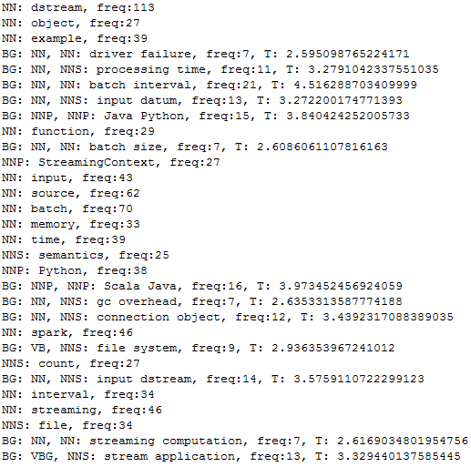
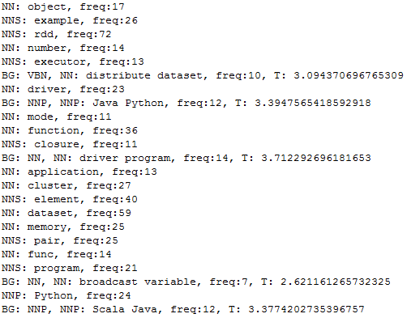
Results – Noun Extraction
Only definitive results for the noun extraction with early filtering yet:
Spark Programming Guide
Spark Streaming Guide

Slide 11
Results – Keyword extraction
These results will contain only the most relevant keywords of those nouns identified before
Just as an example the output of RAKE with standard parameters:
('output operation', 3.909090909090909), ('output operations', 3.857142857142857), ('external systems', 3.8055555555555554), ('akka actors', 3.7142857142857144), ('advanced sources', 3.7), ('batch size', 3.6904761904761907), ('streaming computations', 3.683168316831683), ('broadcast variables', 3.666666666666667), ('cluster resources', 3.65), ('sliding window', 3.5925925925925926), ('batch interval', 3.5870279146141213), ('stateful transformations', 3.571428571428571), ('input stream', 3.5625)

Slide 12
Any Questions?
To be continued…

